Slide 1

Section #x
Kat Gregory | Code in Place | 2021
Week 1 [April 23, 2021]
Self-link: https://bit.ly/2LwGSrG

Slide 2
Welcome to section!
Kat Gregory | Code in Place | 2021

Slide 3
Congratulations!
Kat Gregory | Code in Place | 2021
Notes:
You’re here. That’s awesome. We’re going to learn together.

Slide 4
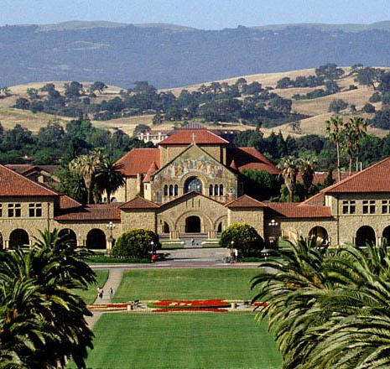
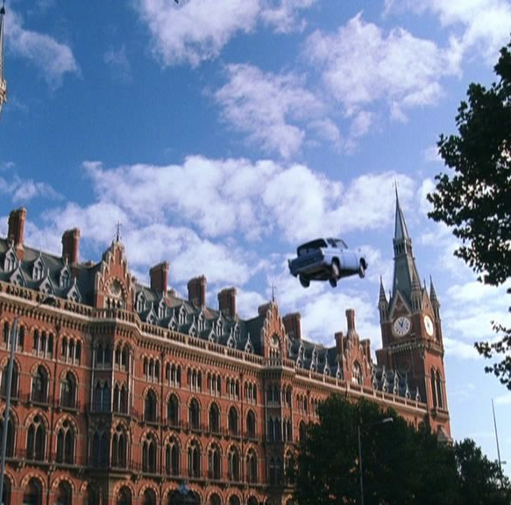
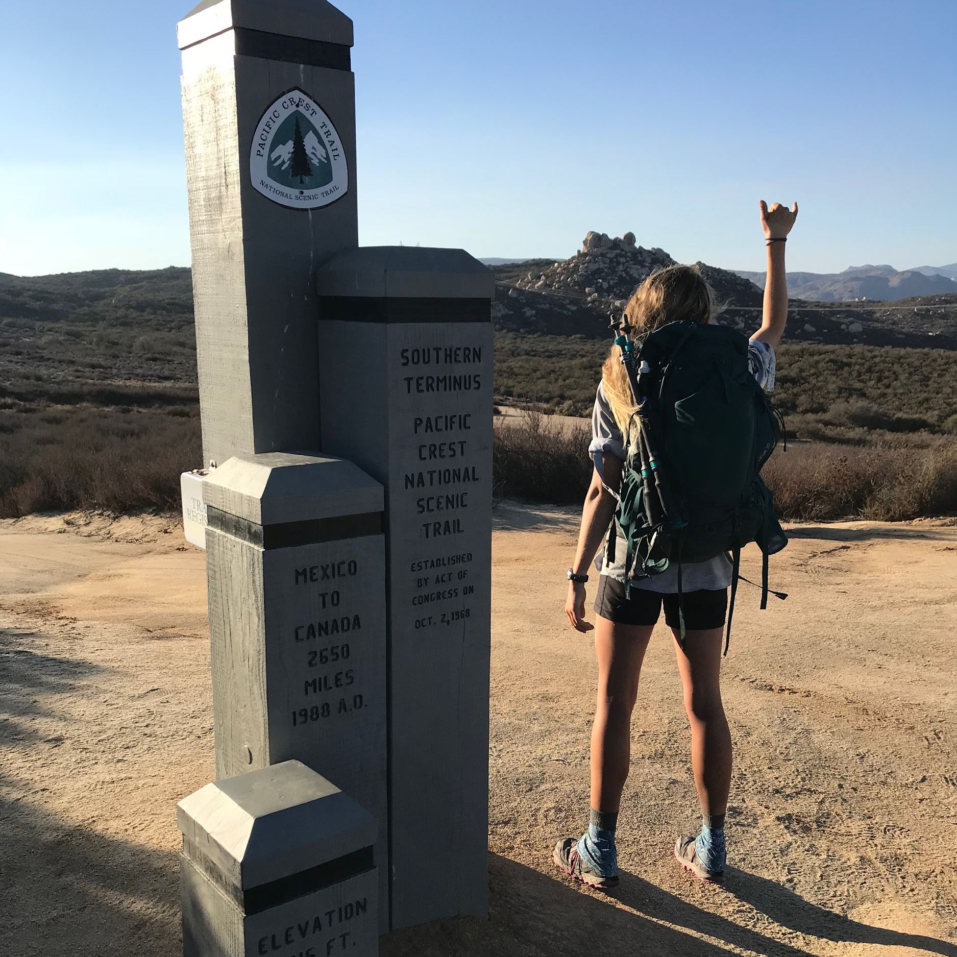
About me
Kat Gregory | Code in Place | 2021

Slide 5
About you!
Kat Gregory | Code in Place | 2021

Slide 6

About you!
Kat Gregory | Code in Place | 2021
Notes:
Icebreaker: I’m sorry to inform you that since we’ve started section, a zombie apocalypse has swiftly spread across the globe. Luckily for us, I’ve been preparing for just such a event, and I have a safehouse stocked with food and supplies and ready to go. However, I’m not taking just anyone on my team! Why should you be part of the team? Be as silly as you’d like.
[Encourage facetious answers. Examples: “I like running. If we get cornered, you can send me off and I’ll lead the zombies on a merry chase in the wrong direction while you escape.”]

Slide 7
Why are we here?
Kat Gregory | Code in Place | 2021
Section is what makes Code in Place different.
section != lecture
Building a community of learners.
Notes:
I’m not here to judge if you didn’t watch lecture. Come to section even if you didn’t watch. Come to section *especially* if you didn’t watch.

Slide 8
How can you get the most out of this time?
Kat Gregory | Code in Place | 2021
This is your time.
Finishing problem isn’t important.
If we run over, no pressure to stay.
Notes:
Interrupt me. Ask questions.

Slide 9
Section 823
Kat Gregory | Code in Place | 2021
Notes:
Sent out a poll to choose a section name. Let’s check out the submissions:

Slide 10

Section 823
Kat Gregory | Code in Place | 2021
Python Panache
Notes:
Proposed by Rachael!

Slide 11
Section 823
Kat Gregory | Code in Place | 2021
Python Panache
Naming Things is Hard
There are two hard things in computer science: cache invalidation, naming things, and off-by-one errors.
Notes:
Proposed by Dachary!

Slide 12
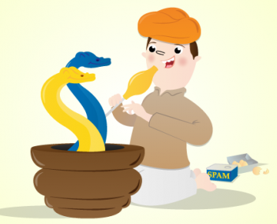
Section 823
Kat Gregory | Code in Place | 2021
Python Panache
Naming Things is Hard
Serpent Charmers
There are two hard things in computer science: cache invalidation, naming things, and off-by-one errors.
Notes:
Suggested by Liene!

Slide 13
Section 823
Kat Gregory | Code in Place | 2021
Python Panache
Naming Things is Hard
Serpent Charmers
???
There are two hard things in computer science: cache invalidation, naming things, and off-by-one errors.

Slide 14
Approaching a problem
Kat Gregory | Code in Place | 2021

Slide 15
Approaching a problem
Kat Gregory | Code in Place | 2021

Slide 16
Approaching a problem
Kat Gregory | Code in Place | 2021
Understand
Write stuff down.
Explain problem out loud to someone.
Draw a picture.

Slide 17
Approaching a problem
Kat Gregory | Code in Place | 2021
Understand
Write stuff down.
Explain problem out loud to someone.
Draw a picture.
Strategize
Walk through an example or two.
Look for patterns.
Think about what things you’ll need: loops, conditions, helper functions, etc.

Slide 18
Approaching a problem
Kat Gregory | Code in Place | 2021
Understand
Write stuff down.
Explain problem out loud to someone.
Draw a picture.
Strategize
Walk through an example or two.
Look for patterns.
Think about what things you’ll need: loops, conditions, helper functions, etc.
Translate
First into pseudocode.
Then into Python.
Notes:
We’ll get lots of practice with this, because this is the way we’ll approach each section problem.

Slide 19
Control Flow
Kat Gregory | Code in Place | 2021

Slide 20
Control flow
Kat Gregory | Code in Place | 2021
if
if/else
for
while

Slide 21
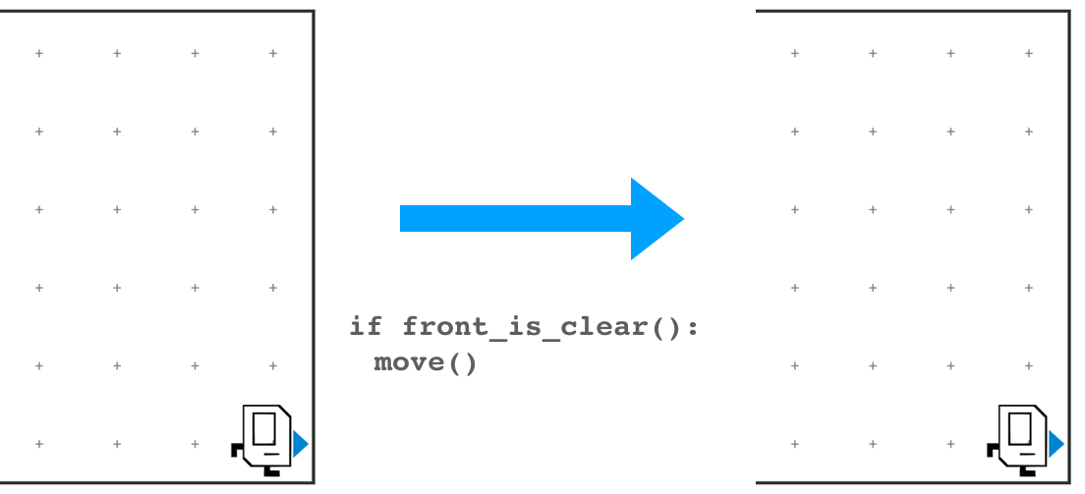
Control flow
Kat Gregory | Code in Place | 2021
if
Do something when a condition is met.
if/else
for
while

Slide 22
Control flow
Kat Gregory | Code in Place | 2021
if
if/else
for
while

Slide 23
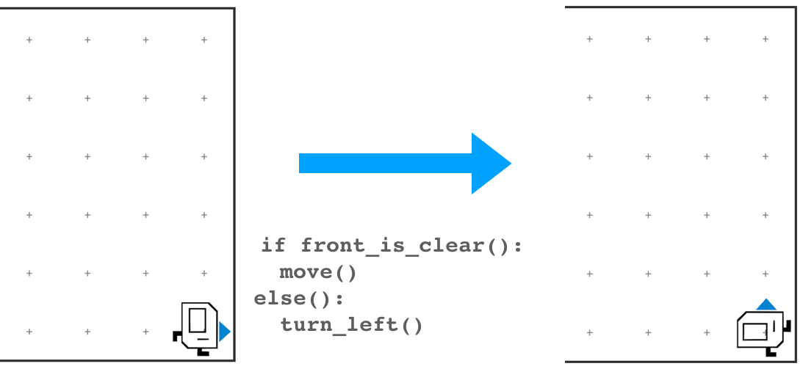
Control flow
Kat Gregory | Code in Place | 2021
if
if/else
Also do something else when a condition is not met.
for
while

Slide 24
Control flow
Kat Gregory | Code in Place | 2021
if
if/else
for
while

Slide 25
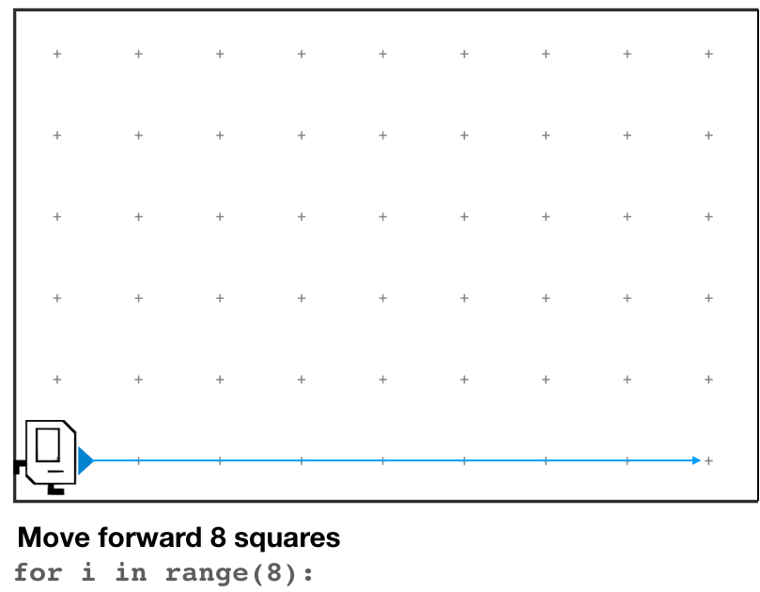
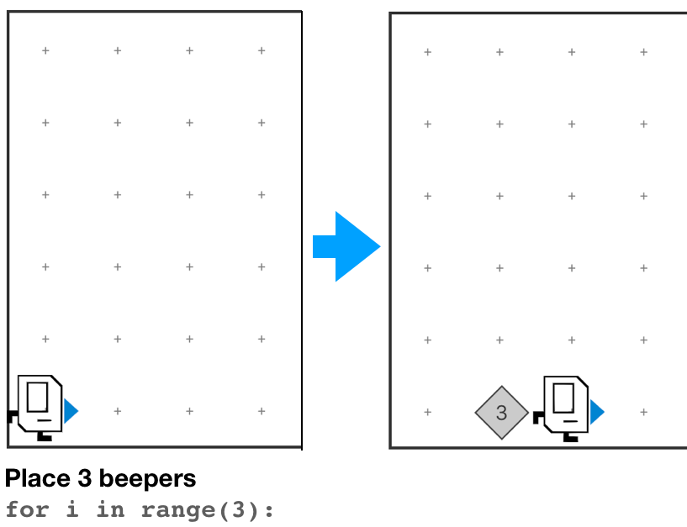
Control flow
Kat Gregory | Code in Place | 2021
if
if/else
for
Do something a set number of times.
while

Slide 26
Control flow
Kat Gregory | Code in Place | 2021
if
if/else
for
while

Slide 27
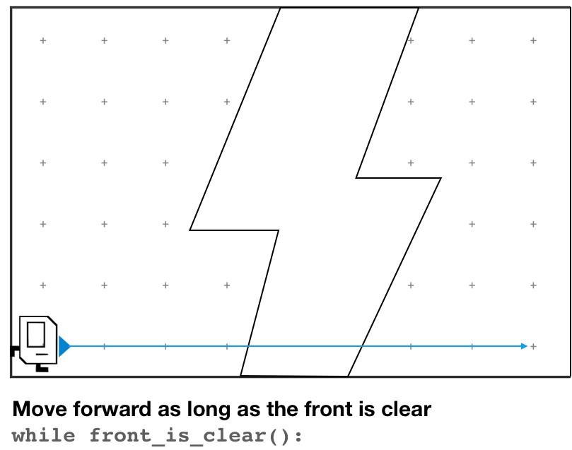
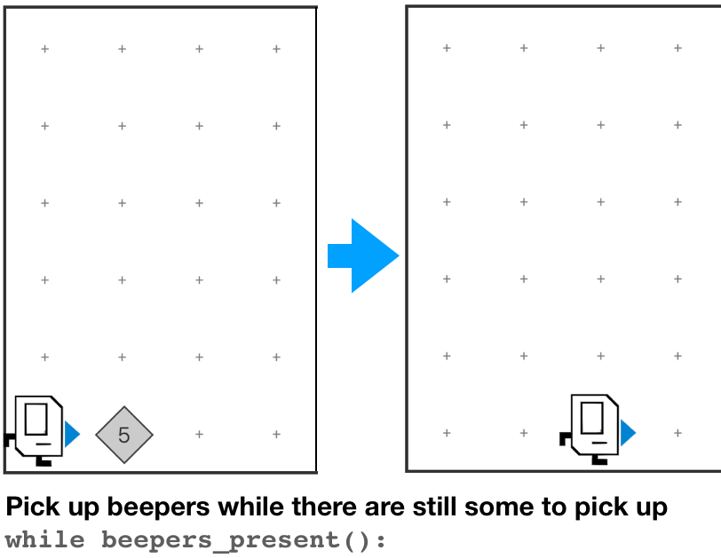
Control flow
Kat Gregory | Code in Place | 2021
if
if/else
for
Do something until condition is no longer true.
while

Slide 28
Control flow
Kat Gregory | Code in Place | 2021
if
no
Do you have a backup plan?
yes
if/else
yes
Is it a one-off?
for
yes
Do you know how many times you need to do it?
no
while
no

Slide 29
Decomposition
Kat Gregory | Code in Place | 2021

Slide 30
Decomposition
Kat Gregory | Code in Place | 2021
Notes:
Break big problem into smaller ones

Slide 31
Decomposition
Kat Gregory | Code in Place | 2021
Define your function like this:
def function_name():
<write code here>
And call it like this:
function_name()

Slide 32
Decomposition
Kat Gregory | Code in Place | 2021
More of an art than a science.
Functions should be short and read like English.
If you repeat things (or find yourself hitting copy/paste), take a step back.
Top-down programming & the leap of faith.

Slide 33
Decomposition
Kat Gregory | Code in Place | 2021
def main():
turn_left()
turn_left()
turn_left()
turn_left()
turn_left()
turn_left()
turn_left()
turn_left()
turn_left()
turn_left()
turn_left()
turn_left()

Slide 34
Decomposition
Kat Gregory | Code in Place | 2021
def main():
turn_left()
turn_left()
turn_left()
turn_left()
turn_left()
turn_left()
turn_left()
turn_left()
turn_left()
turn_left()
turn_left()
turn_left()
def main():
spin()
spin()
spin()
def spin():
turn_left()
turn_left()
turn_left()
turn_left()
Notes:
Does this code do the same thing?
Is this code easier to read/understand?
Is this code easier to write?

Slide 35
Pre/Post conditions
Kat Gregory | Code in Place | 2021
Each helper function defines a contract.

Slide 36
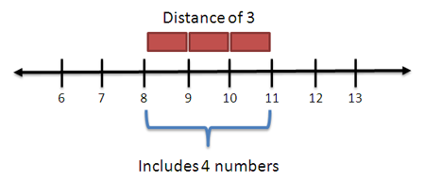
Fencepost problem
Kat Gregory | Code in Place | 2021

Slide 37
HospitalKarel
Kat Gregory | Code in Place | 2021
Handout here

Slide 38
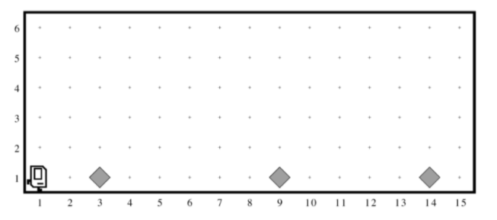
Kat Gregory | Code in Place | 2021
Example precondition

Slide 39
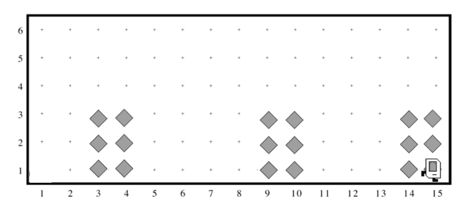
Kat Gregory | Code in Place | 2021
Example postcondition

Slide 40
More thoughts
Kat Gregory | Code in Place | 2021

Slide 41
Getting started
Kat Gregory | Code in Place | 2021
Setting up your environment is hard.
You only have to do this once.

Slide 42
Karel
Kat Gregory | Code in Place | 2021
Visual = tangible. Run/watch to understand what you’re code is doing.
Constraints because of narrow language → Creativity!
Algorithmically challenging!
Edge conditions.

Slide 43
Follow-ups from questions
Kat Gregory | Code in Place | 2021
Notes:
Notes added in response to questions from section.

Slide 44
Python style
Kat Gregory | Code in Place | 2021
PEP 8 style guide is a great resource!
Recommends snake_case_capitalization over camelCaseCapitalization

